Slide 1
Code Generation
These are the good bits

Slide 2
What a long, strange trip it’s been…
My Program
List<lexeme>
AST
AST
AST
Compiled Code!
Lexical Analyzer
Parser
Semantic Analysis
Optimization
Code Generator

Slide 3
Code Generation Basics
This is the process of generating assembly
Obviously, this is CPU specific – this is the only part of the compiler that is CPU specific!
A simple approach is very simple; highly optimized is hard
Can never be “perfect”, but can be “good enough”
Much like parsing, this is a “fill in the blank” problem

Slide 4
It’s hard to talk about code generation…
… unless you know assembly
Here are some basics:
This is the “native language” of the CPU; different for each “model” Very simple instructions
You have to manage memory and even your local variables
No blocks {} – you can jump/branch (goto) addresses in memory
You have to manage the stack…

Slide 5
The Stack
You know the stack data structure. The CPU typically has a stack built in.
When you call a function, you push the parameters onto the stack.
When you get back, you pop them off.
The CPU uses the stack to store the return address of the function.
Local variables are also stored on the stack.
The stack is just an area of memory.

Slide 6
Registers
Memory, in a modern computer, is slow compared to the CPU (300X)
There is some special memory built into the CPU that is fast (1X)
There is only a little of this memory. We can use it as fast local variable storage. This memory is split into word sized divisions called “registers”.
Most machines have 10-20 registers. We will represent them as R0-Rn

Slide 7
Ready to start compiling?
Almost. We are going to use a simplification that came from the late 80’s called SSA (single static assignment). We “pretend” that we have infinite registers and that each one is only assigned once.
Why? It simplifies code generation.
It adds another pass later to convert our infinite registers back to what a CPU actually has.

Slide 8
Some typical assembly instructions
Instruction | Description | Example
MOVE const Rx | move a constant to a register | MOVE 5 R1
JUMP addr | jump to an address | JUMP 10
COMPARE Rx Ry | compare the content of two registers | COMPARE R2 R3
BRANCHIFxx address | xx = (eq)ual, (ne) not equal, (gt) greater than, (lt) less than, (ge) greater or equal, (le) less or equal branch to address if previous compare matches | BRANCHIFEQ 10
PUSH Rx | push contents of the register to the stack | PUSH R3
POP Rx | pop a number off of the stack into a register | POP R2
ADD Rx Ry Rz | add contents of Rx to Ry and store result in Rz | ADD R1 R2 R3
SUBTRACT Rx Ry Rz | subtract contents of Rx from Ry and store in Rz | SUBTRACT R7 R2 R6
MULTIPLY Rx Ry Rz | multiply contents of Rx times Ry and store in Rz | MULTIPLY R2 R5 R8
CALL address | Call a function at address, storing return address | CALL 100
RETURN | Return from the last function call | RETURN

Slide 9
Our overall algorithm
We will visit each node in our AST.
Some nodes will have work to do before the children are processed.
Some nodes will have work to do after the children are processed.
Some nodes will have both.
When we are done, we will have output that does what our AST does.

Slide 10
Consider our “math” nodes:
In our AST, we have nodes for add, subtract, etc.
One might look like this:
Add
5
3

Slide 11
Algorithms for these nodes
Add
For a node with a number, we can use MOVE to put that in a register. For these constant nodes, there are no children, so we can use either the before children or after children functions:
MOVE 5 R1
MOVE 3 R2
One important detail – the registers chosen here have to be passed up to the “add” visitor
Const 5
Const3

Slide 12
Now for add…
Add
Clearly, we can’t tell what to do with add until after we have dealt with the children.
Here, add should, in the “after children” function, generate an add instruction that takes the registers from the two children and adds them:
ADD R1 R2 R3
Const 5
Const3
MOVE 5 R1
MOVE 3 R2
ADD R1 R2 R3

Slide 13
What if our expression is a more complex?
x = 9 – (2*3)
This is actually already done!
Subtract resolves children first.
Generate MOVE 9 Rx
Multiply resolves children first
Generate MOVE 2 Ry
Generate MOVE 3 Rz
Generate MULTIPLY Ry Rz Ra
Generate SUBTRACT Rx Ra Rb
Subtract
Const 9
Multiply
Const 2
Const3

Slide 14
So far, this is pretty easy
Let’s think about an if-else block.
Can we re-write this into simple if with goto? Did you even know Java has goto?
Remember a “label” in Java:
if (x<5) goto myLabel;
System.out.println(“big x!”);
myLabel: return;

Slide 15
Re-write if in Java
if (count==0) {
average = 0;
}
else {
average = total / count;
}
System.out.println(average);
if (count!=0) goto elsePart;
average = 0;
goto end;
elsePart: average = total/count;
goto end;
end: System.out.println(average);

Slide 16
Re-write if in Assembly
if (count!=0) goto elsePart;
average = 0;
goto end;
elsePart: average = total/count;
goto end;
end: System.out.println(average);
COMPARE count,0
BRANCHNOTEQUAL elsePart
MOVE 0,average
JUMP end
elsePart: DIVIDE total,count,average
JUMP end
end: PUSH average
CALL printLn

Slide 17
Re-write while in Java
while (x<10)
x+=1;
// whatever
loopBody: if (x>=10) goto end;
x+=1;
goto loopBody;
end: // whatever

Slide 18
Re-write while in Assembly
loopBody: if (x>=10) goto end;
x+=1;
goto loopBody;
end: // whatever
loopBody:COMPARE x,10
BRANCHIFNOTLESS end
ADD 1,X,X
JUMP loopBody
end: ;whatever

Slide 19
Function Calls
Function calls vary by CPU and/or operating system; the caller and the callee have to agree on how it is to be done.
int x = addTwoNumbers(4,6)
First, we will push the parameters on the stack. Then we will call the function. Then, when the function returns, we will pop the return value from the stack.

Slide 20
Function Calls
int x = addTwoNumbers(4,6)
MOVE 4, R0
PUSH R0
MOVE 6,R1
PUSH R1
CALL addTwoNumbers
POP R2 ; R2 holds X
STORE R2,X

Slide 21
How could we write code for this?
For each of our AST nodes, we could define two methods that do the work specific to our particular node:
int OutputPreChildren()
int OutputPostChildren()
These will return the register number of the result.
We can assume that only one of these will produce a result.
We will also want to have a function to get the next available register:
int getNextRegister();

Slide 22
How could we write code for this?
On our Node base class, we could have a function that handles a single node;a combined pre-order, in-order and post-order traversal:
int ProcessNode() {
int retVal = OutputPreChildren();
for (Node child:children)
child.ProcessNode();
int retVal2 = OutputPostChildren();
return retVal2 == 0 ? retVal : retVal2;
}

Slide 23
What else?
Our variables are all stored in registers right now.
There are two issues with this:
We will run out of registers on a real computer.
We haven’t talked about how to work with data that is not 1 register in size. Examples include classes and arrays.

Slide 24
So how do registers get allocated?
Goals:
Most usage of registers
Fewest memory transactions
Reasonable Compile Time
Provably error free
No side effects
All of this has to happen regardless of basic block boundaries (much harder!)

Slide 25
Liveness Analysis
Determine which variables are “alive” (referenced) during which pieces of code and put those into registers.
Swap out variables at the end of their “lives” to free up the register for something else.
Prioritize loops to ensure that code that is executed many times is as fast as possible, even if it means that code executed only once is slower.

Slide 26
Example of liveness analysis
void someFunction(void) {
int a=5,b=3;
for (int i=0;i<100;i++) {
a+=i;
}
b = 5;
print a,b;
playSound();
}
You could start out by considering
a and b as “alive” –
Note the loop with i. It should get prioritized as going into a register since it will be heavily used
It turns out that we didn’t really need b since it wasn’t read from before being reassigned. We can go back and update the liveness to make it not live until now.
Neither a nor b is ever used, so they are both “dead”. Their registers could be reused.

Slide 27
Code generation wrap-up
Generating code from the AST is pretty straight forward, but requires some recursion.
Register allocation is an NP complete (no fast, perfect solution is known)
What we have is “good enough” for register allocation

Slide 28
Working with memory
As you may know, memory is represented to the programmer as a long array of untyped bytes.
We choose to organize the memory allocated to our program in two different ways, representing two very different usage patterns.
One pattern is our local variables. They live only for the duration of a single method/function call. The other pattern is for allocations that will probably last for a long time (think “new” in Java).

Slide 29
The stack
We have already talked about the stack as a way to pass parameters to functions. We can also use it to allocate memory for our local variables.
The “secret” is that we can change the stack address. Push and pop, strictly, only give us access to the topmost item on the stack. We need more flexibility than that.

Slide 30
Here we have an empty stack.
We are going to call a function:
void doSomething (int a) {
int b=4;
return a+b;
}

Slide 31
void doSomething (int a) {
int b=4;
return a+b;
}
First, we will push the return location
Return Location

Slide 32
void doSomething (int a) {
int b=4;
return a+b;
}
Next, we will push the value for a
5 (value for a)
Return Location

Slide 33
void doSomething (int a) {
int b=4;
return a+b;
}
Now we call doSomething. First we need to make space for b
4 (value for b)
5 (value for a)
Return Location

Slide 34
void doSomething (int a) {
int b=4;
return a+b;
}
How can we access either a or b?
The CPU has instructions that can treat a register as a pointer (think reference in Java) and allow you to access memory relative to that register.
Stack Pointer
SP - 1
4 (value for b)
SP - 2
5 (value for a)
Return Location

Slide 35
void doSomething (int a) {
int b=4;
return a+b;
}
When our function is complete, it cleans up all of the local variables and the space for the parameters and pushes the return value.
Stack Pointer
9 (return value)
Return Location

Slide 36
void doSomething (int a) {
int b=4;
return a+b;
}
When we call “return”, the return location and the return value are removed from the stack, leaving it in the same state that it was in when we called the function.
Stack Pointer
9 (return value)
Return Location

Slide 37
4 (value for b)
Stack Pointer
5 (value for a)
void doSomething (int a) {
int b=4;
doSomething(a)
}
This is why your recursive code can cause the system to fault. While the stack is big enough for reasonable recursion, if your base case is wrong, you will keep adding function call frames until it breaks.
Return Location
4 (value for b)
5 (value for a)
Return Location
4 (value for b)
5 (value for a)
Return Location
4 (value for b)
5 (value for a)
Return Location

Slide 38
Wrap up of the stack
Super fast – adding or subtracting from the stack pointer register
Only short term – for the length of your function
Good for passing parameters and holding the return value
Dangerous if you try to use that memory outside of your function
Java prohibits you from doing this

Slide 39
The Heap
The stack is only for short durations. The heap is for long durations.
How should we organize heap memory?
Goals:
Space efficiency
Fast to allocate and free

Slide 40
Simplest possible thing
Don’t free memory. Just allocate forever.
Good – FAST, bug free
Bad – not space efficient
This might not be as bad as it sounds – when a program ends, the whole heap is freed by the operating system. For many programs that only run for a short time, this is not a bad solution!

Slide 41
The Buddy System
We start with the whole heap as one area of memory.
When someone allocates space, find the smallest area that is big enough to satisfy their allocation.
We check to see if we could still satisfy the allocation if we break that area is half. If so, we split the area. We do this until the allocation would not be satisfied any more.

Slide 42
Example – buddy system
I can now return this to the requester. All of the other pieces are available for allocation.

Slide 43
Example – freeing in the buddy system
I check to see if the freed area’s buddy is also free. If so, I merge and recurse.

Slide 44
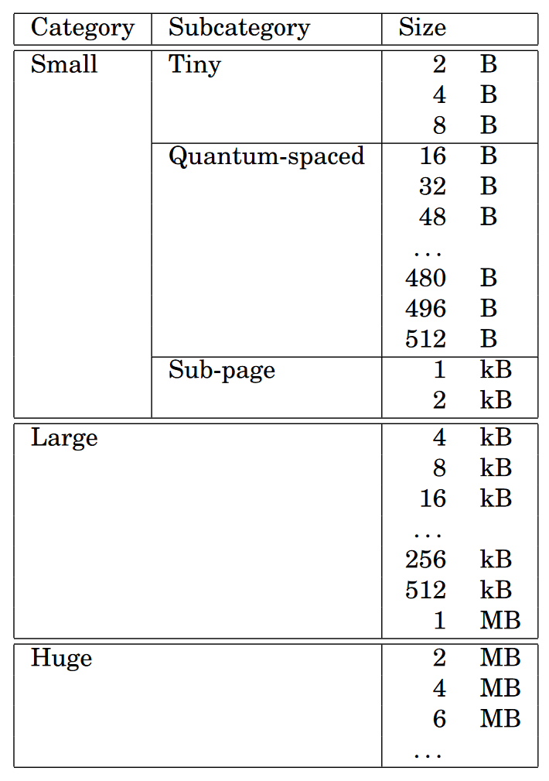
Optimization – unnecessary merges/splits
Imagine if you had a program that allocated and split 1 byte of memory over and over. There would be TONS of merges and splits for no reason.
Modern buddy systems pre-define pools of areas and then run the buddy system on those pools. One such allocation scheme appears on the right. (credit to jemalloc.net)

Slide 45
Heap/Memory wrap-up
We allocate memory for our compiled programs to use.
Very short term memory comes from the stack.
Longer term memory comes from the heap.
It is up to the compiler writer to handle both stack and heap. The operating system supplies us space, we have to manage it.

